Slide 1










Whiteboardmaths.com
7
2
1
5
© 2004 All rights reserved

Slide 2
Types of Angle
Acute angles
1
2
3
Acute angles are angles less than 90º

Slide 3

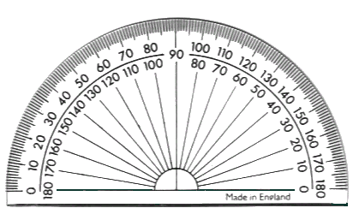
Types of Angle
Right angles
If the angle between two lines is a right angle then the lines are perpendicular to each other.
90º on a protractor
A right angle will occur when a horizontal line and a vertical line meet.
Vertical
Horizontal
A right angle is an angle of 90º
Horizontal
Horizontal
1
2
3
Vertical
Vertical
Vertical
Horizontal

Slide 4
Types of Angle
Right angles
Perpendicular lines
Vertical
Horizontal
Perpendicular lines

Slide 5
Which simple shapes contain right-angles?

Slide 6
Can Pentagons, Hexagons and Octagons have right-angles?
6
5
8
six
five
Eight
Regular Hexagon
Regular Pentagon
Regular Octagon
Irregular Pentagon
Irregular Hexagon
Irregular Octagon

Slide 7
Types of Angle
Obtuse angles
1
2
3
Obtuse angles are greater than 90º but less 180º

Slide 8
What types of angle can you see in the shapes below?
6
5
8
six
five
Eight
Regular Hexagon
Regular Pentagon
Regular Octagon
Irregular Pentagon
Irregular Hexagon
Irregular Octagon

Slide 9
Types of Angle
Straight angles
180º on a protractor
180º on a protractor
A straight angle is an angle of 180º

Slide 10
Types of Angle
Reflex angles
1
2
3
4
Reflex angles are greater than 180º but less than 360º

Slide 11
1
2
3
Acute
Obtuse
Acute
4
5
6
Right
Reflex
Obtuse
7
8
9
Acute
Reflex
Obtuse

